Slide 1

Welcome Time Management/ Study Skills
Presented by: Julia Harrington,
Finance Instructor
October 23, 2024

Slide 2

A bit about myself
Started at CSCC in 2010
I have identical twin boys
I am a veteran
I ran a marathon in 2005 ~ Ohio is flat ☺
I love to hear the violin

Slide 3

Time Management

Slide 4

Time Management Overview
Manage your time by your priority
Do one thing at a time
Schedule in margin
Plan in advance

Slide 5
Time Management
30% of college freshmen won’t return for their second year. (Complete College America)
Why?
Poor time management skills
Poor sleep and health habits
Mental health issues: anxiety, burnout
Poor balance of school versus work

Slide 6

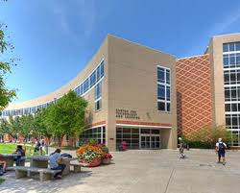

Time Management :Priority
What is your priority this semester?
- Work, school, kids, taking care of parents
- All the above? How will we manage this?

Slide 7

Time Management Priority
Create a large picture schedule
Write down daily tasks – effective !
Schedule in margin ( catch up or relax)

Slide 8
Big Picture on Time
What are your three largest chunks of time?
Does your priority equal your time spent on them?
How can you make your priority and time connect?
- say “ No” ??

Slide 9


Daily Check List
Write it down ~ Homework notebook
-Is a phone effective for you ? Or is it a distraction
Pro: Con:
-accessible - distracting
-quick calendar - could die
Put a time frame around your work
Cross it off

Slide 10

Avoid Procrastination
By doing the toughest thing first
-Eat That Frog by Brian Tracy
Return to your check list
You can relax that you have started your hardest task
-Tutor, contact the teacher, Net Tutor
https://www.cscc.edu/services/tutoring.shtml

Slide 11
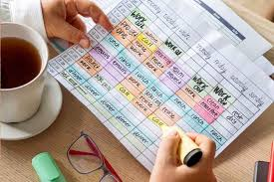

Time management worksheet

Slide 12

Effective Study Skills in Time Management
Go to class and take notes. Notebook vs laptop??
Pro laptop: Con laptop:
-quick typing - distraction, emails incoming
-auto save - gaming
-spell check - shopping
- ? - ?
- **** Review the class material, even for 5 -10 minutes after class

Slide 13

High School vs. College

Slide 14
High School vs. College
Check the syllabus!
High School | College
Learning mostly during class. | Learning mostly outside of class.
Homework and notes are graded. | Homework and notes are often not graded.
Teachers remind you of due dates. | You need to know due dates.
Missed work is made-up. | Strict make-up/late work policies.
Attendance tracked and required. | Attendance is your choice.
Extra credit offered. | Extra credit usually not offered.
Teachers offer help if you have low grades. | You must seek out help to improve your grade.
https://www.cscc.edu/services/tutoring.shtml

Slide 15
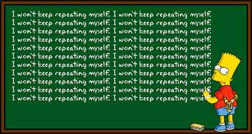
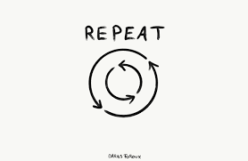
Effective Study Skills in Time Management
Repetition***
Schedule your review sessions in chunks of short increments
Take breaks in “ study sessions”
Do one thing at a time

Slide 16
Questions?
Student Financial Wellness
Columbus State Community College is dedicated to helping students make wise financial decisions throughout their lifetime, from planning and paying for college to starting a career and beyond. Each semester, we offer multiple services:
A Mobile Student Financial Wellness Center (see below for details).
talktoafinacemajor@cscc.edu - An email resource for you to ask financial questions from current advanced finance students.
Workshops and forums featuring top industry experts presenting on different financial wellness topics
https://www.cscc.edu/services/financial-wellness/

Slide 17
Thank you!

